Slide 1
Industrial Evaluation
Poulami Bose
1705424

Slide 2

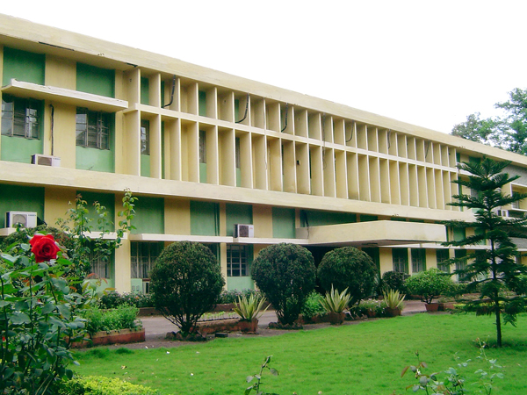
Tata Steel Long Products LTD BILEIPADA,JODA

Slide 3
About The Company
Tata Steel Long Products Limited is one of India’s largest merchant sponge iron manufacturers. Tata Steel Long Products is now a subsidiary of Tata Steel, wherein Tata Steel holds 75.91% shareholding.
The company has a huge and compact IT department to track the KPI system of production of sponge,iron and it's alloy and a great efficient SAP management system which includes all the benifits of their employees with travel management ,food management,leave management system ,so that it need less human resources and can be done in digitilisation method.

Slide 4
Summer Training-2019
Summer Training
Date-13.05.2019-13.06.2019
Mentor-Mr. Santosh Pattnayak,Mr. Kalandi Charan Acharya &Mr.Dusmanta Barik(Dept. Of ITS,TATA SPONGE IRON LIMITED,BILEIPADA,JODA)
Traing Subjects-A new tool,Microsoft Visual studio -2010,ultimate professional with it's excellent features in Ado.netframework using C# Language.

Slide 5
covered various basics concepts of OOPS to advanced level of .netframework which included both frontend as well as backend part of GUI based application.
Online Examination System(GUI window based application)
Tools-Microsoft visual studio 2010,ultimate professional using c# language where backend part was done using sql query and plsql programming language and frontend part was done using drag and drop features of the tool with it's buisness logic file.

Slide 6
Online Examination System
The project features of conducting examination in an online mode which was done in 3-tier architecture ,which has admin and user mode both ,so that at a time both of them can use the system independently.
It includes a login page for each individual admin and user.
For admin,there are 3 sections,question group,question master,Answer master,studentdetails and report and for student it's exam details and it's result which can be given anually only.

Slide 7
Data Flow Diagram

Slide 8
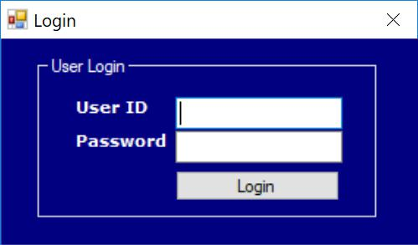
USER INTERFACE
The Screen is the main screen,which provides the user with different submenus to perform their desired operations.

Slide 9
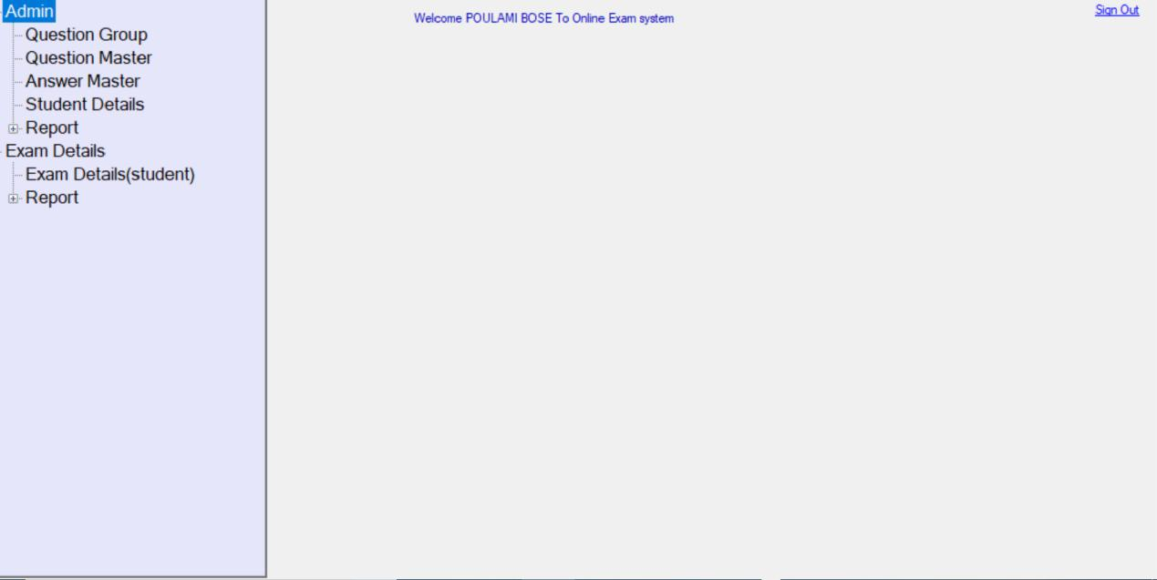
Home Page
The Screen is the main screen,which provides the user with different submenus to perform their desired operations

Slide 10
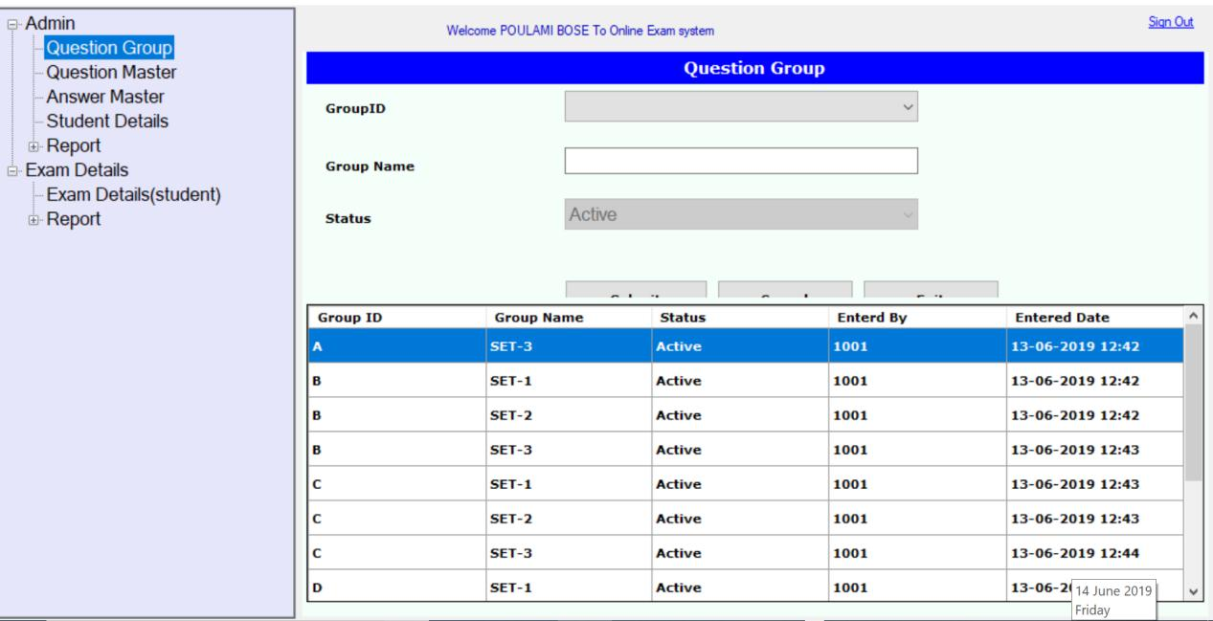
Question Group
The above Screen is the Question Group,which provides the Admin to provide different group name or question sets for the students appearing the exam .

Slide 11
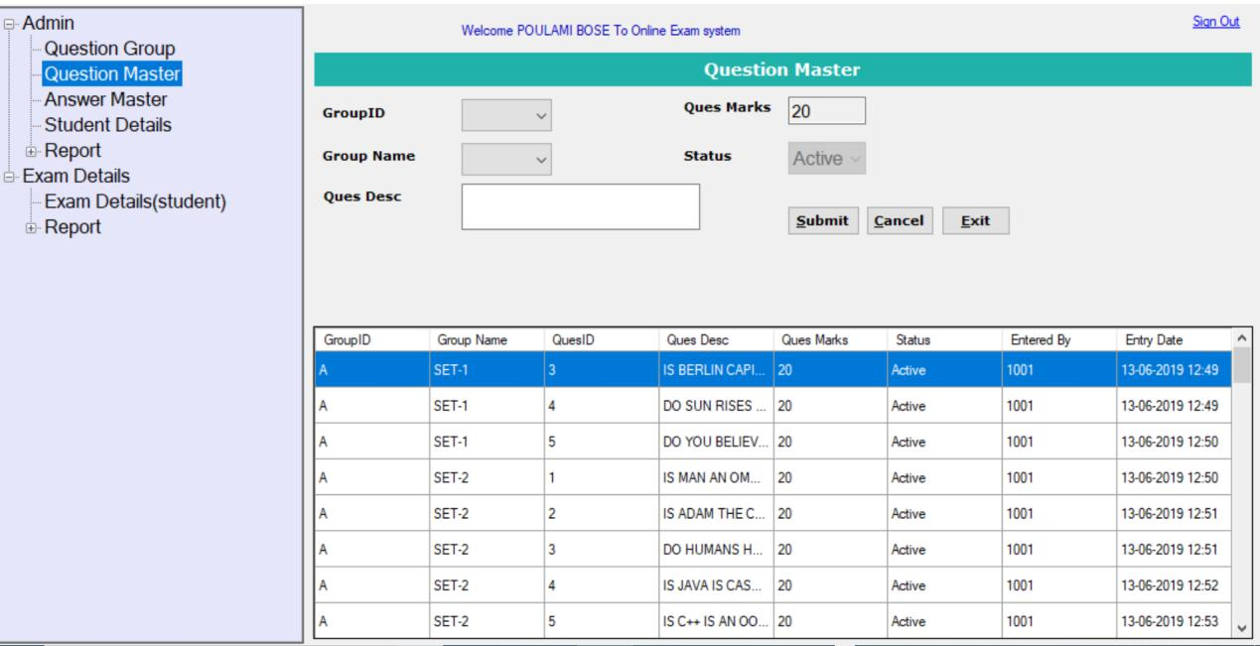
Question Master
The above screen is the Question Master,where the admin can set different questions for the respective group with it’s selected set of questions.

Slide 12
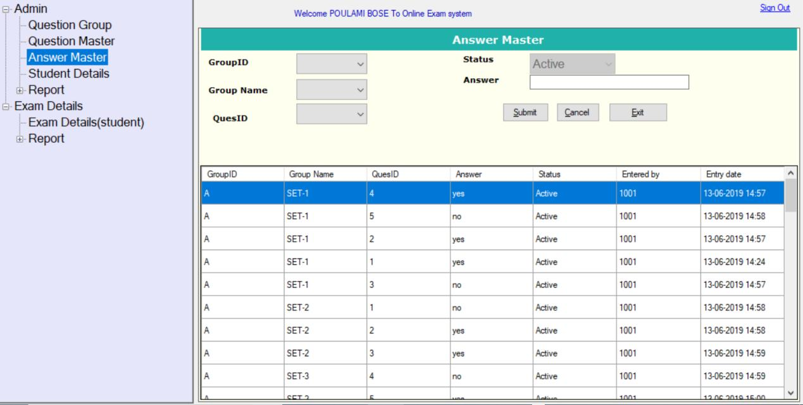
Answer Master
The above screen is the Answer Master,where the admin can set different questions for the respective group with it’s selected set of questions.

Slide 13
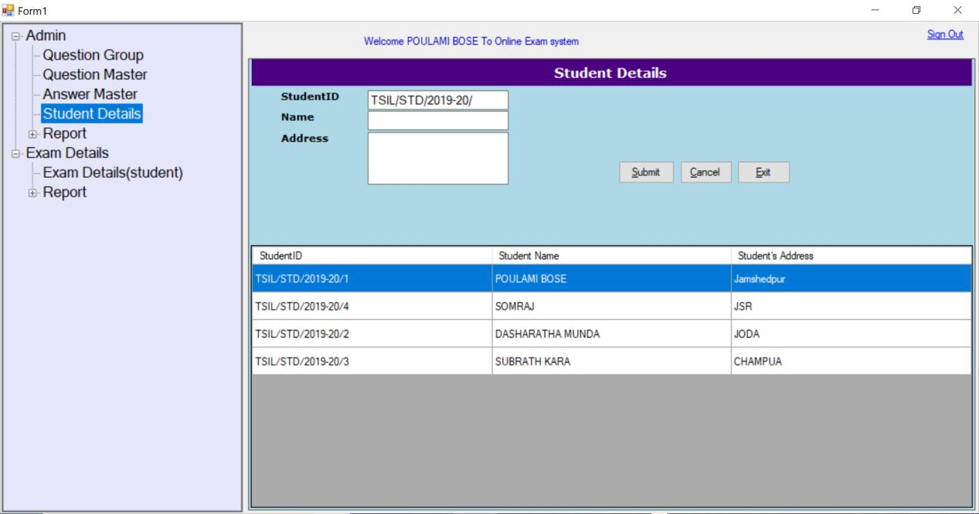
Student Details
The following screen explains the details of the student for the registeration so the admin can generate the userid which is the studentID and Password in thge UserLogin table .

Slide 14
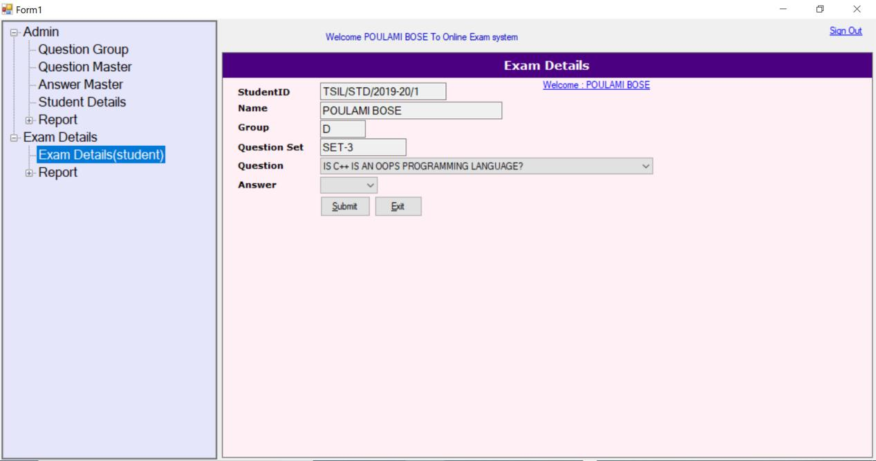
Exam Details
The above screen leads the student as the user for appearing the exam by selecting the exam details where by the student will get a random group with it’s respective question sets which is a random set

Slide 15
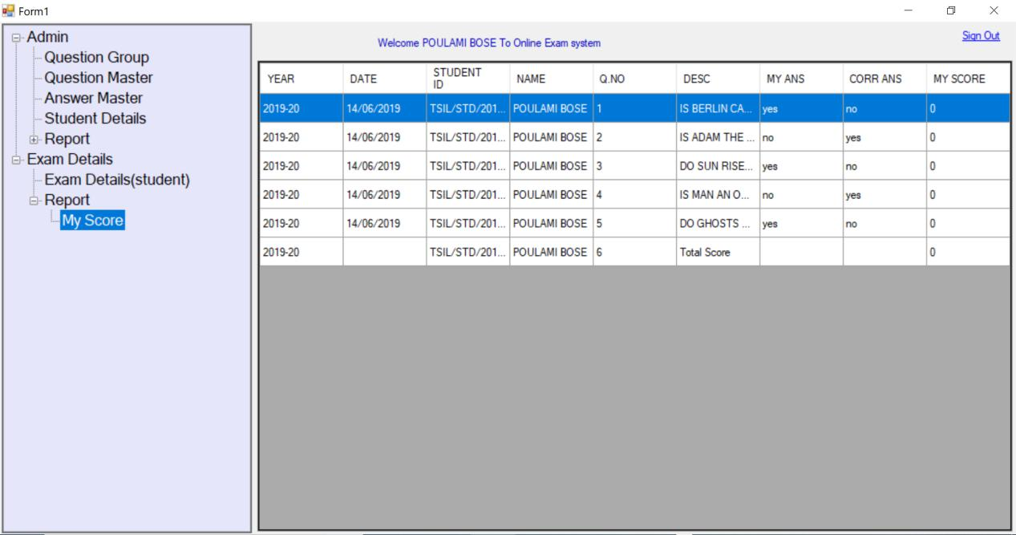
My score-Report
The above screen is for the user as the student can see the correct answers which will check whether it matches with the answer in the answer master and if it matches it will generate the score and at last the overall score will be shown at the end.

Slide 16
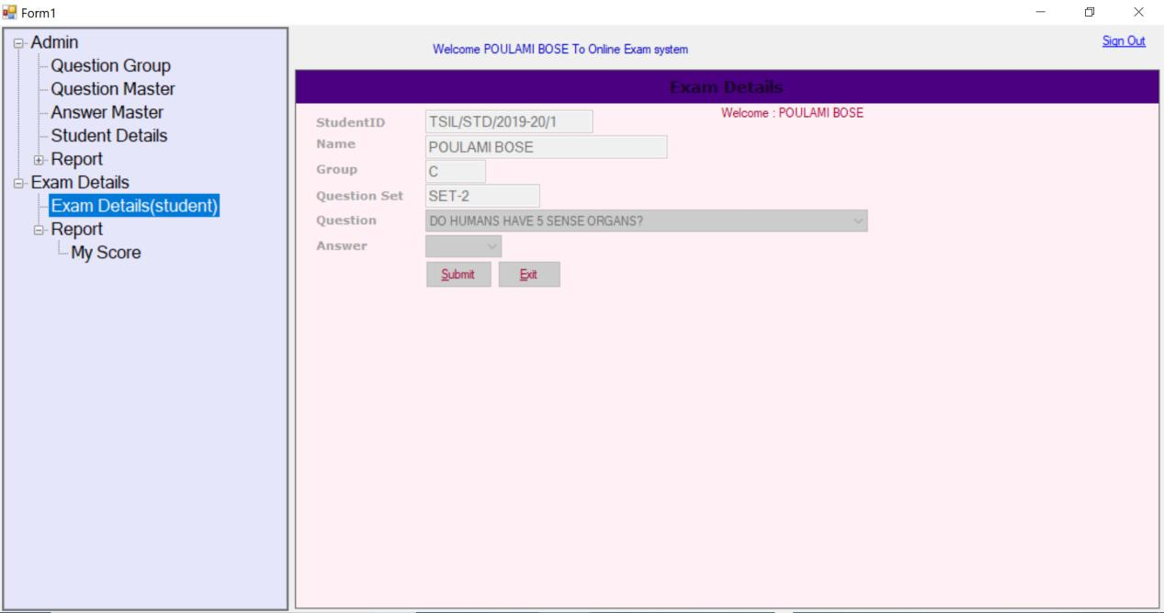
Annual Exam System
The screen displayed above will be shown if the same student wants to appear for the test then the system will restrict him or her for appearing the exam as he/she can only appear for the exam once in the year.

Slide 17
Review of Training
During this one month course , I was being guided through each and every moment by my respected mentor Mr Kalandi Acharya who made my basics and concepts regarding programming language very clear & simple. I have ever known before about such a versatile technology or tool named visual basic studio 2010 Proffessional which contains more than 72 different programming languages..Firstly I learnt about the concepts of oops and then UI/UX designing and finally about the database.It was a great pleasure for me to learn such an interesting programming language c# which

Slide 18
has such a wide use in the corporate world for designing website ,desktop and various mobile applications.Beyond whatever I learnt from my college was something theoretical as it was a teaching and learning process but here in one month I actually learnt the implentation of my theoretical knowledge into the real world field.I learnt how to put my concepts and knowledge in designing a new application by keeping all the compliexities as time-space mangement and saving human resources.I ended up my one month course by concluding a project based on online -Exam for the students.

Slide 19
Training Certificate

Slide 20
Thank You!

